Slide 1
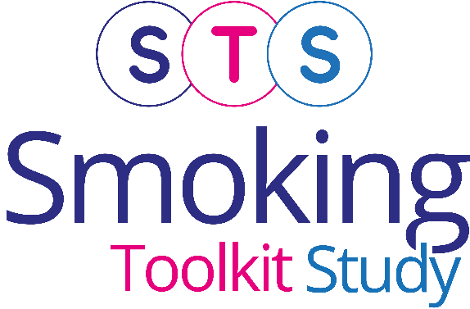
Top-line findings on smoking in England from the Smoking Toolkit Study
Vera Buss
Robert West
Dimitra Kale
Loren Kock
Jamie Brown
Last updated: 18th March 2025
www.smokinginengland.info
jamie.brown@ucl.ac.uk

Slide 2
Cigarette smoking prevalence
Base: Adults (16 and over till Feb 20; 18 and over from April 20; 16 and over from Jan 22)
Graph shows prevalence estimate and upper and lower 95% confidence intervals

Slide 3
Smoking prevalence
Base: Adults (16 and over till Feb 20; 18 and over from April 20; 16 and over from Jan 22)
Any tobacco includes cigars, pipes, shishas, etc.
Graph shows prevalence estimate and upper and lower 95% confidence intervals

Slide 4
Change in cigarette smoking prevalence
Base: Adults (16 and over till Feb 20; 18 and over April 20-December 2021)

Slide 5
Cigarette smoking prevalence in 18-to-21-year-olds
Base: Aged 18-21
Graph shows prevalence estimate and upper and lower 95% confidence intervals
Notes:
d

Slide 6
Cigarette smoking prevalence in 16-to-17-year-olds
Base: Aged 16-17; NB data collection stopped in Feb 2020
Graph shows prevalence estimate and upper and lower 95% confidence intervals
Notes:
d

Slide 7
Stopped smoking in past 12 months
Base: Adults who smoked in the past year
Graph shows prevalence estimate and upper and lower 95% confidence intervals
Notes:
d

Slide 8
Tried to stop smoking in past year
Base: Adults who smoked in the past year
Graph shows prevalence estimate and upper and lower 95% confidence intervals

Slide 9
Success rate for stopping in those who tried
Base: Smokers (adults) who tried to stop in the past year
Graph shows prevalence estimate and upper and lower 95% confidence intervals

Slide 10
Tried to stop smoking in past year (aged 18-24)
Base: Smokers (18-24)
Graph shows prevalence estimate and upper and lower 95% confidence intervals
Notes:
d

Slide 11
Success rate for stopping in those aged 18-24 who tried
Base: Smokers (18-24) who tried to stop in the past year
Graph shows prevalence estimate and upper and lower 95% confidence intervals
Notes:
d

Slide 12
Uptake: prevalence of ever smoking in those aged 18-24
Base: Aged 18-24
Graph shows prevalence estimate and upper and lower 95% confidence intervals
Notes:
d

Slide 13
Methods
Monthly household surveys of representative samples of 1700-1800 adults (16+ years old) in England
Due to the pandemic, from April 2020 to December 2021 surveys conducted by telephone (rather than face-to-face) and among adults aged 18 and over. From January 2022 data collection resumed among those aged 16 and over
Between November 2020 and February 2022, ~0.8% of cases in England were incorrectly weighted 0. This has now been updated and some point estimates over this period have changed slightly (typically 1 d.p.) compared with earlier versions.
From April 2020 (switch to telephone), Ipsos started recording ~<5% cases as missing for social grade. To derive weight variable (which uses social grade), Ipsos assumed missing = social grade C1. To ensure analyses using weight and social grade reflect target weighed profile, social grade was recoded to reflect this assumption. Different assumptions for missing social grade cases were explored in a parallel telephone and face-to-face (with no missing social grade) wave, and this assumption found least distorting.
Fieldwork by TNS/BMRB 2006 up to April 2013, then IPSOS MORI
Sample weighted to match population in England on key socio-demographics
Further details: www.smokinginengland.info

